Slide 1
Cancer progression and therapeutic response: a role for agent-based and multiscale modelling
Alexander Fletcher
University of Sheffield
Quantitative Systems Biology Workshop (03/11/17)

Slide 2
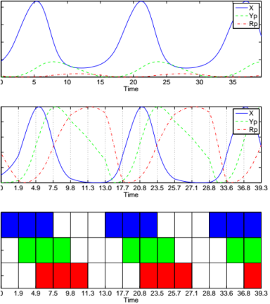
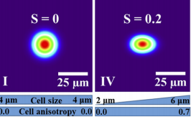
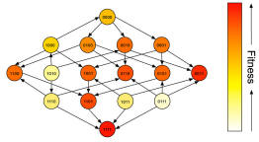
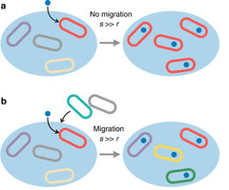
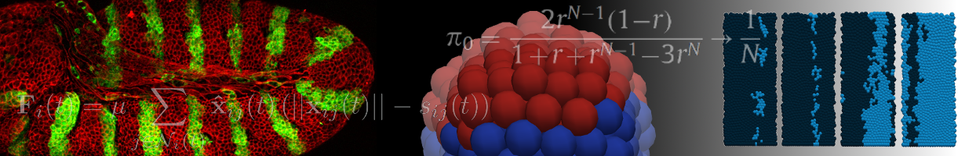

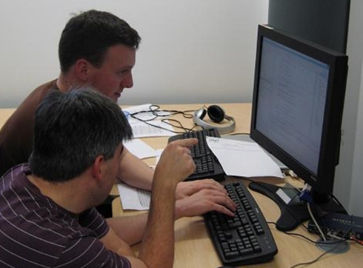
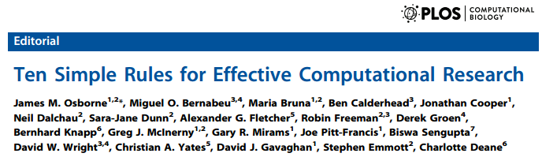

Slide 3
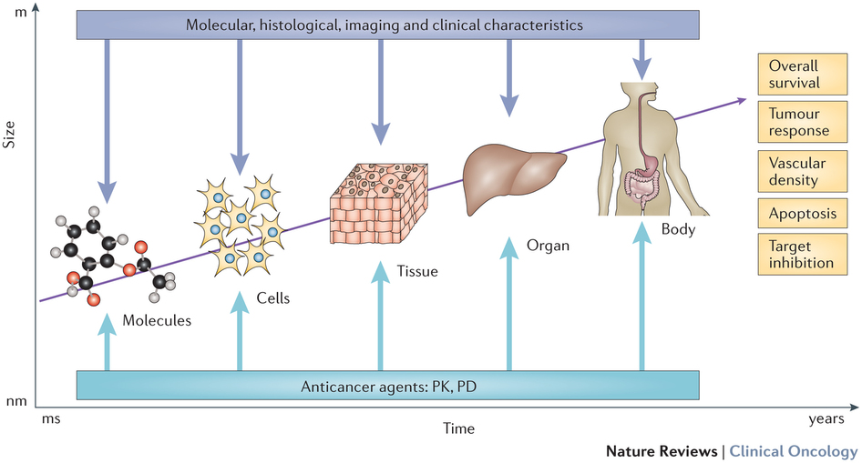
Cancer as a multiscale process
doi:10.1038/nrclinonc.2015.204

Slide 4
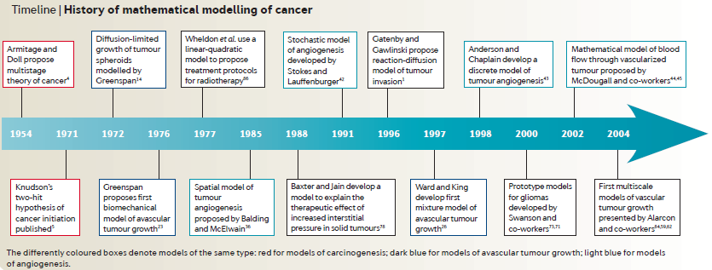
Cancer as a multiscale process
doi:10.1038/nrc2808

Slide 5
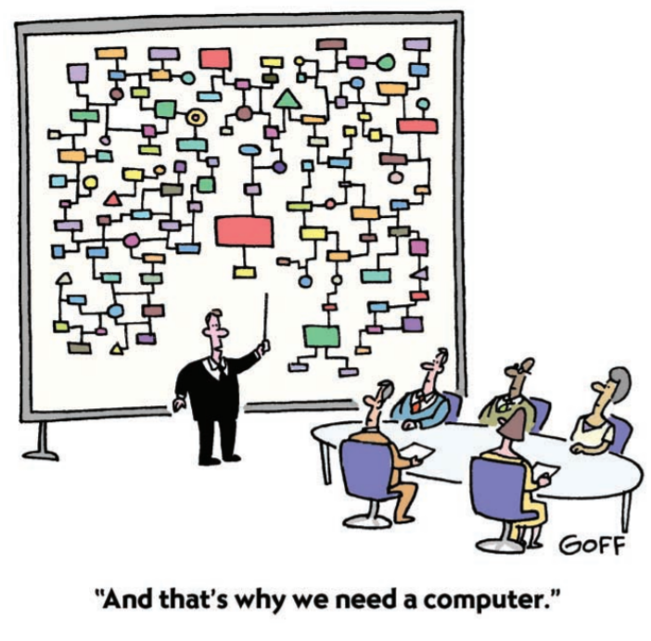
doi:10.1083/jcb.200303202
Notes:
Computational modelling allows the dynamic interactions of cellular structures, components, and pathways
to be probed not only in a quantitative manner, but also with the ability to make quantitative predictions.
Systems biology approaches are taking advantage of computational methods to acquire and analyze
interaction networks with the goal of mapping networks and finding patterns of regulation within them.

Slide 6
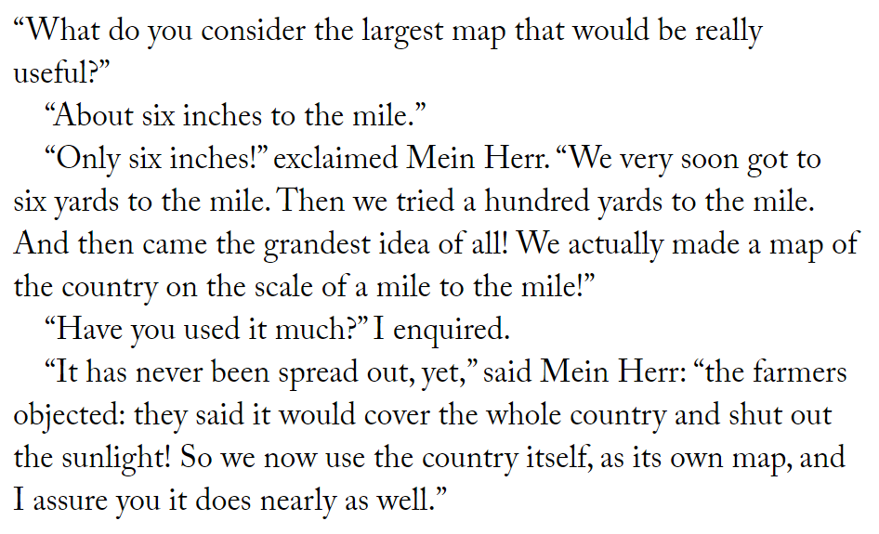
Lewis Carroll, Sylvie and Bruno Concluded

Slide 7
Different model types
Verbal models
Boolean models
Focus on network wiring; ‘on/off’ dynamics
Differential equation models
Continuous concentrations; nonlinear dynamics
Spatial models
Protein transport; chemical gradients
Multiscale models

Slide 8
Uses of mathematical modelling
Explanatory modelling
Predictive modelling
Explore theory, generate hypotheses
Provide a candidate explanation for observed patterns
Difficult to test establish whether informative
Quantitative calibration and validation against observations
Used to simulate perturbations and make predictions on outcome
Risk of overfitting, lack of identifiability, overuse
Notes:
Just as there are different types of models, each with their own characteristic features, advantages, and disadvantages, there are different ways that a model can be used
Consideration of these allows a clearer understanding of what distinguishes a good or bad model

Slide 9
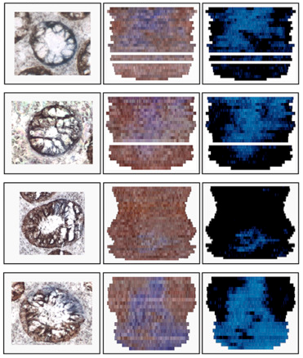
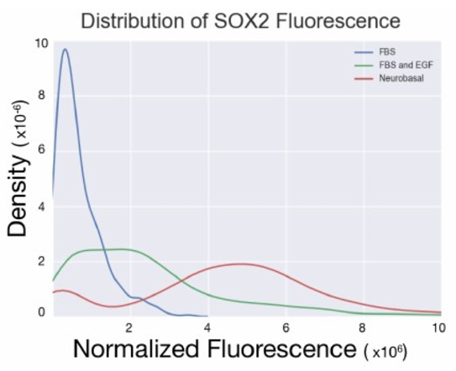
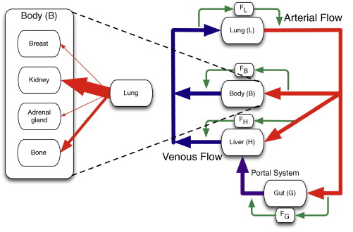
Intestinal crypt evolution
Vascular organisation, radiation efficacy
Cancer stem cells and clonogenicity
Haematogenous metastasis

Slide 10
A computational modelling approach for deriving biomarkers for cancer risk in premalignant disease

Slide 11
Motivation
Cancer risk is increased in patients with premalignant disease, yet the overall rate of progression to cancer is still typically very low
Yet these patients are routinely offered a place in a longitudinal surveillance program for early cancer detection
Much of this screening is unnecessary
Premalignant diseases can be considered over-diagnosed
Notes:
Barrett's Oesophagus: the overall lifetime risk of developing adenocarcinoma is increased 40-fold; rate of progression is estimated to be less than 0.1\% per patient per year; patients are enrolled onto endoscopic screening regmines that looks for early morphological signs of cancer (called dysplasia) - an average risk patient will be surveyed every 3 years\cite{BSG

Slide 12
Lack of prognostic biomarkers
Accurate risk stratification would spare unnecessary treatment and worry
Risk stratification usually occurs by analysing a biomarker from a biopsy of the affected tissue
Current biomarkers have yet to attain widespread clinical use
For many diseases, no prognostic biomarkers have been identified
Developing effective biomarkers for determining prognosis in premalignant disease is critical
Notes:
Biomarker = some property that is predictive of cancer risk
Many diseases: include DCIS and inflammatory bowel disease

Slide 13
Evolutionary predictors?
Cancer development is fundamentally an evolutionary process
Repeated rounds of mutation and clonal selection can lead to the development of a malignant tumour
A biomarker is a predictor of the evolutionary trajectory of a premalignant disease
The usual approach to biomarker development is to find a gene that is aberrantly expressed in high-risk cases
Yet there are many different combinations of genetic alterations and gene expression changes that contribute to the same malignant phenotypes
Notes:
The acquisition of random somatic mutations can confer a selectively-advantageous phenotype to a cell, providing it with an evolutionary advantage over its neighbours and so driving the clonal expansion of the mutant.
When viewed from this evolutionary perspective
a successful biomarker is one that sensitively and specifically detects that the preamaligant lesion is (rapidly) evolving towards cancer

Slide 14
Heterogeneity and evolution
A single gene is unlikely to represent the plethora of different ways of developing cancer
Measures of within-tumour heterogeneity (as assays of lesion evolvability) are relatively efficacious biomarkers
Measures of the evolutionary process may be efficacious biomarkers of cancer progression
A heterogeneous environment
may be able to withstand stresses in a more robust manner
has evolved further from a neutral state, so have clones of higher fitness
has more complex growth patterns
Notes:
The acquisition of random somatic mutations can confer a selectively-advantageous phenotype to a cell, providing it with an evolutionary advantage over its neighbours and so driving the clonal expansion of the mutant.
When viewed from this evolutionary perspective
a successful biomarker is one that sensitively and specifically detects that the preamaligant lesion is (rapidly) evolving towards cancer

Slide 15
Within-tumour heterogeneity
Phenotypic differences through IHC markers
Ki-67 – proliferation
CD31 –vascularization
CD44, CD24 / CD133 – putative cancer stem cells (breast / glioma)
ER, PR, HER2/neu (breast)
Genetic and epigenetic changes
Specific mutations in EGFR / c-KIT (non-small cell lung / GI stroma)
HTP sequencing of intratumoural regions
EGFR expression (CRC) – cetuximab
Highly specific and sensitive gene panel testing
Oncotype DX (risk of recurrent breast cancer and response to chemo)

Slide 16
A role for mathematical modelling
Models of tumour evolution tend to focus on rates of invasion and accumulation of mutations
Instead, we will evaluate in silico a range of tumour properties that may provide prognostic information, and spatially-based biomarkers that can be used in a biopsy setting
Which measure(s) of heterogeneity are predictive of increased risk for neoplastic change and time to progression of neoplasia?

Slide 17
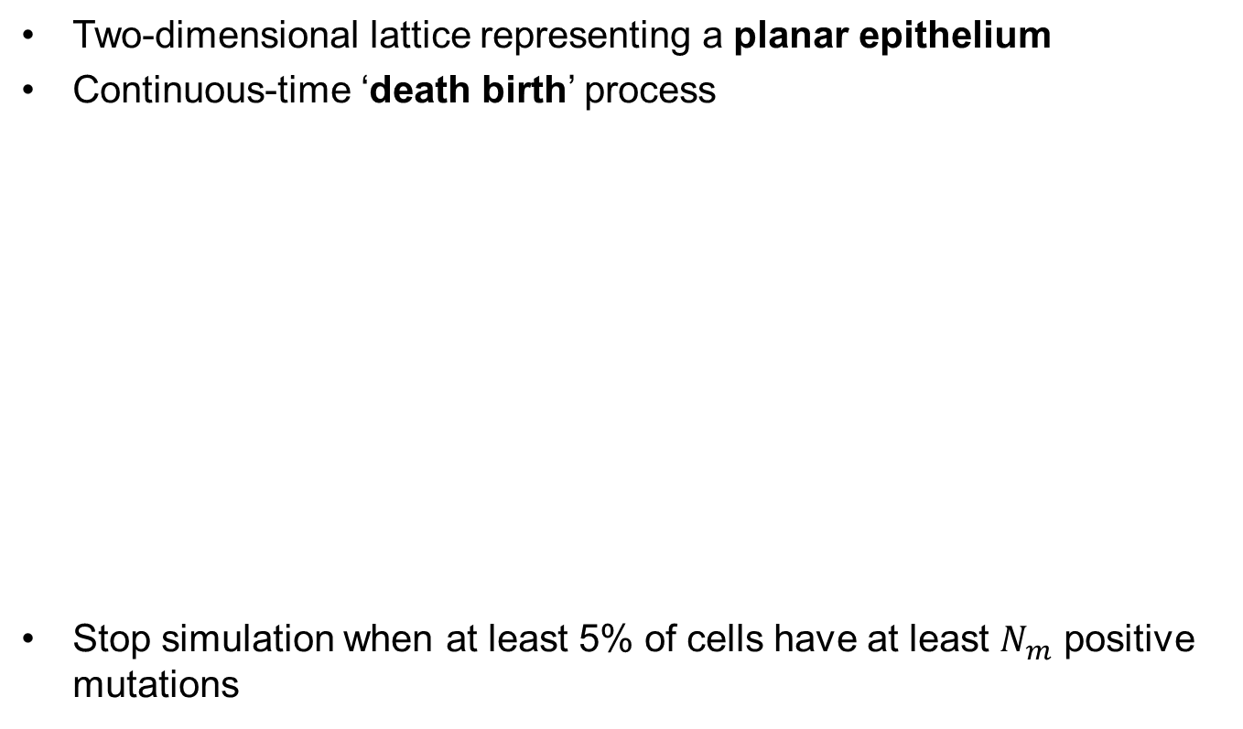
A spatial model of clonal evolution
Two-dimensional lattice representing a planar epithelium
Continuous-time ‘death birth’ process
Stop simulation when at least 5% of cells have at least $N_{m}$ positive mutations
Choose cell to die (fitness dependent)
Choose cell to divide (fitness independent)
Decide if positive, neutral or deleterious mutation occurs

Slide 18
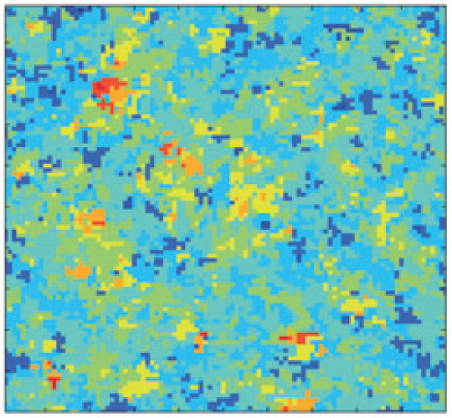
Virtual biopsies and scrapings

Slide 19
Traditional biomarkers
Proportion of cells above a specified number of mutations
Past a certain number of positive mutations, there is an observable change
Simulations use at least two positive mutations as a cutoff
E.g. EGFR mutation staining (lung adenocarcinoma)
Proportion of mitotic cells
E.g. Ki-67 staining, or counting mitotic figures
Notes:
HPF = high power field

Slide 20
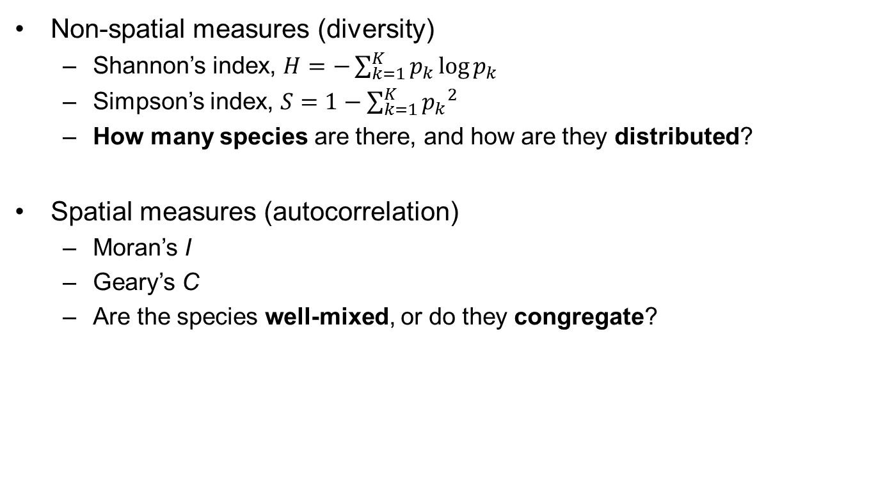
Existing measures of heterogeneity
Non-spatial measures (diversity)
Shannon’s index, $H=−\sum_{k=1}^{K}{p_{k}\log{p_{k}}}$
Simpson’s index, $S=1−\sum_{k=1}^{K}{{p_{k}}^{2}}$
How many species are there, and how are they distributed?
Spatial measures (autocorrelation)
Moran’s I
Geary’s C
Are the species well-mixed, or do they congregate?

Slide 21
Can we predict survival?
Probability of no cancer
Red: Top
Green: Upper middle
Blue: Lower middle
Black: Lowest
Time

Slide 22
Results
Current clinical measures are not great
Existing measures of diversity are okay
Shannon’s and Simpson’s indices
Existing measures of spatial heterogeneity are bad
Can we do better?

Slide 23
“Proliferation indices”
Look at where cells are dividing, and what types of cells are dividing
More division in areas that are genetically closer to cancer, should mean higher risk to cancer
Clinically:
Where?
Stain for Ki-67
Look for mitosis
What types?
IHC markers
Genotyping

Slide 24
Does it work?
Group index values into quartiles, and create Kaplan-Meier curves
Red: Top
Green: Upper middle
Blue: Lower middle
Black: Lowest

Slide 25
Is it good? Theoretical maxima
Absolute correlation coefficient
Time

Slide 26
Is it good? Biopsies
Time

Slide 27
Conclusions and future work
Traditional biomarkers show poor correlation with endpoint
Existing diversity measures are fairly good predictors
Existing spatial heterogeneity measures are poor predictors
Proliferation indices theoretically are good predictors
Multiple biopsies can be helpful, but come at a cost
Serial biopsies are generally not helpful
Future: clinical validation; more practical measures for f_{i} ; better models!
Dhawan A, Graham TA, Fletcher AG (2016). A computational modelling approach for deriving biomarkers to predict cancer risk in premalignant disease. Cancer Prev Res 9:283-295.

Slide 28
Inferring tumour proliferative organization from measures of diversity and heterogeneity

Slide 29

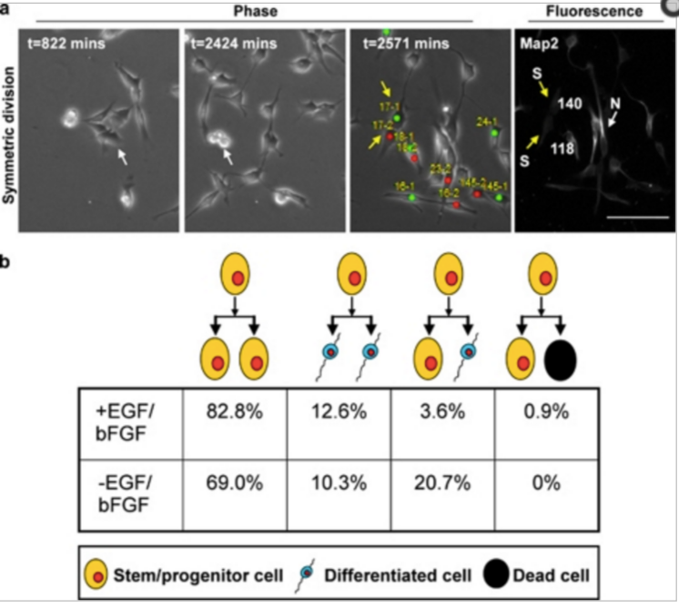
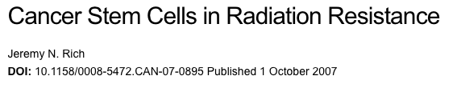
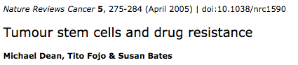
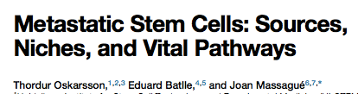
Measuring symmetric division is HARD

Slide 30
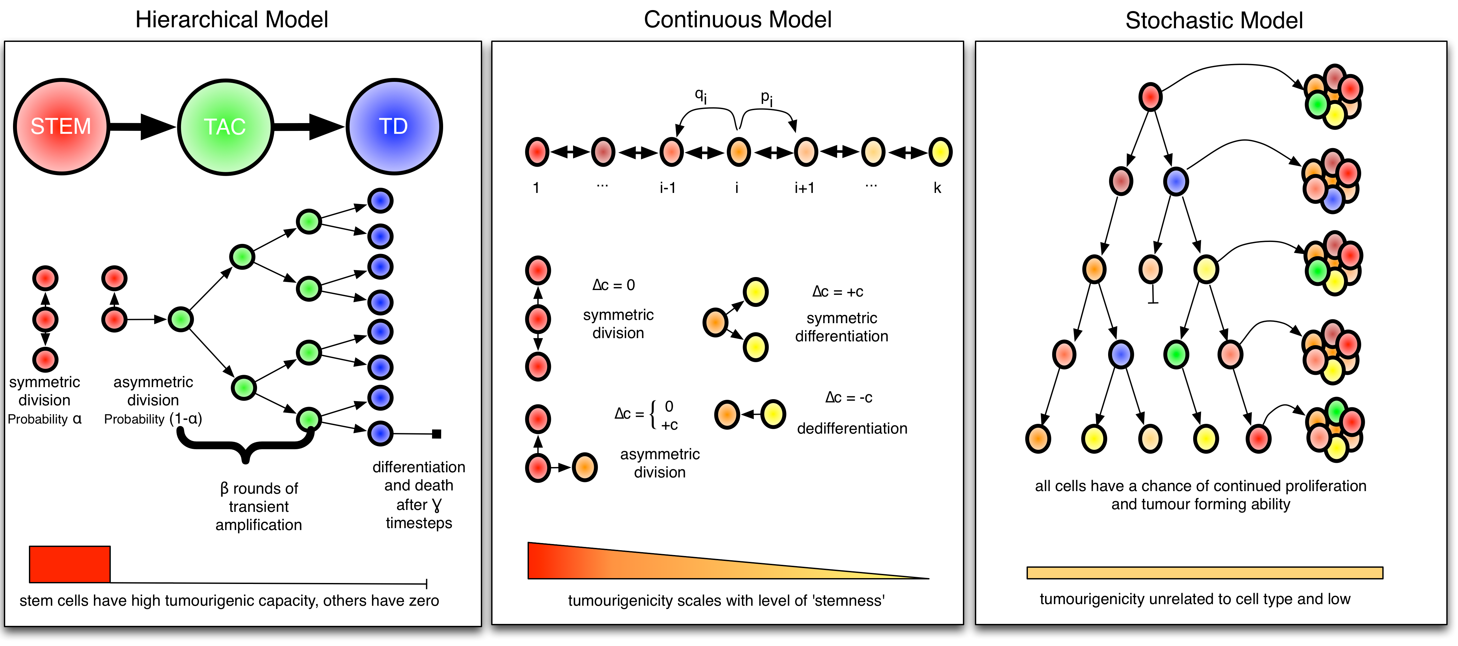

Slide 31
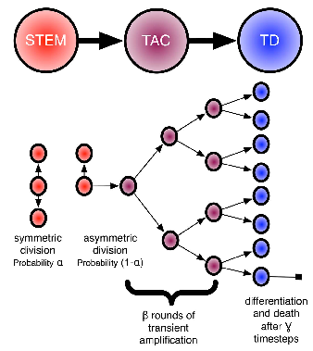
A spatial model of neutral evolution

Slide 32
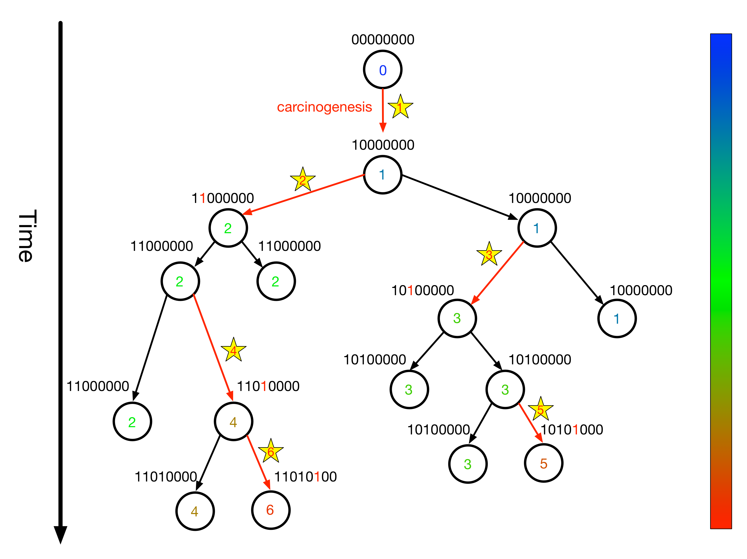
Mutation schema

Slide 33
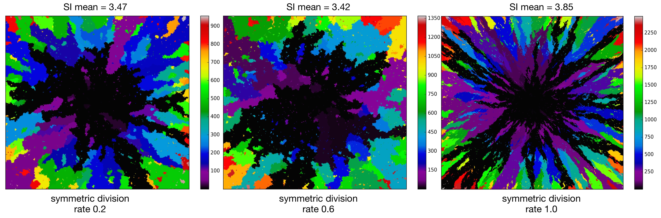
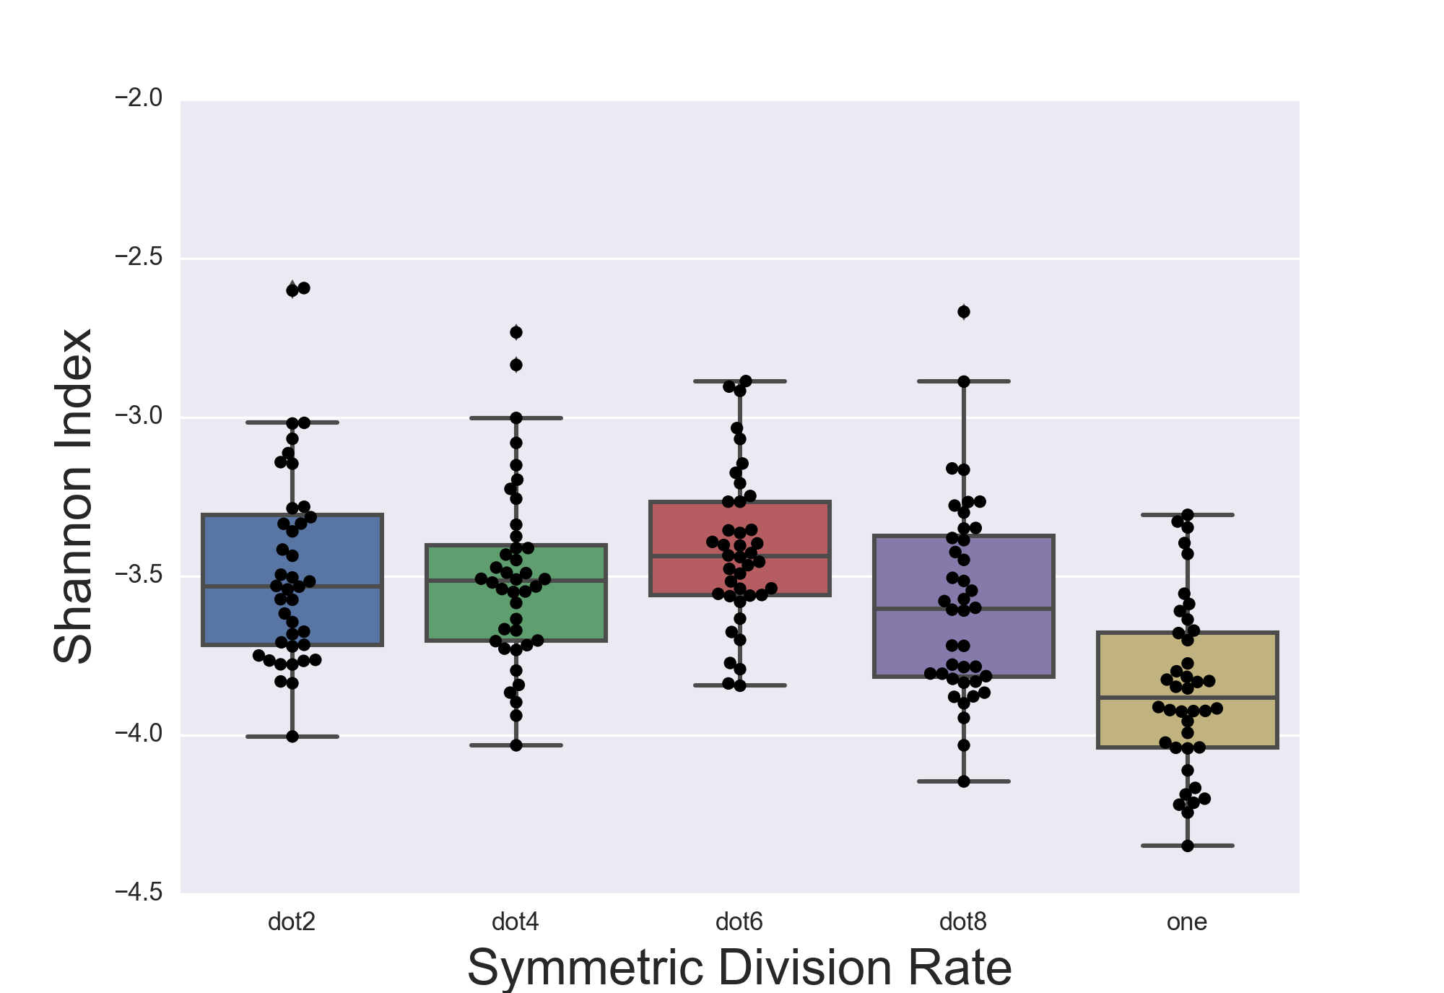
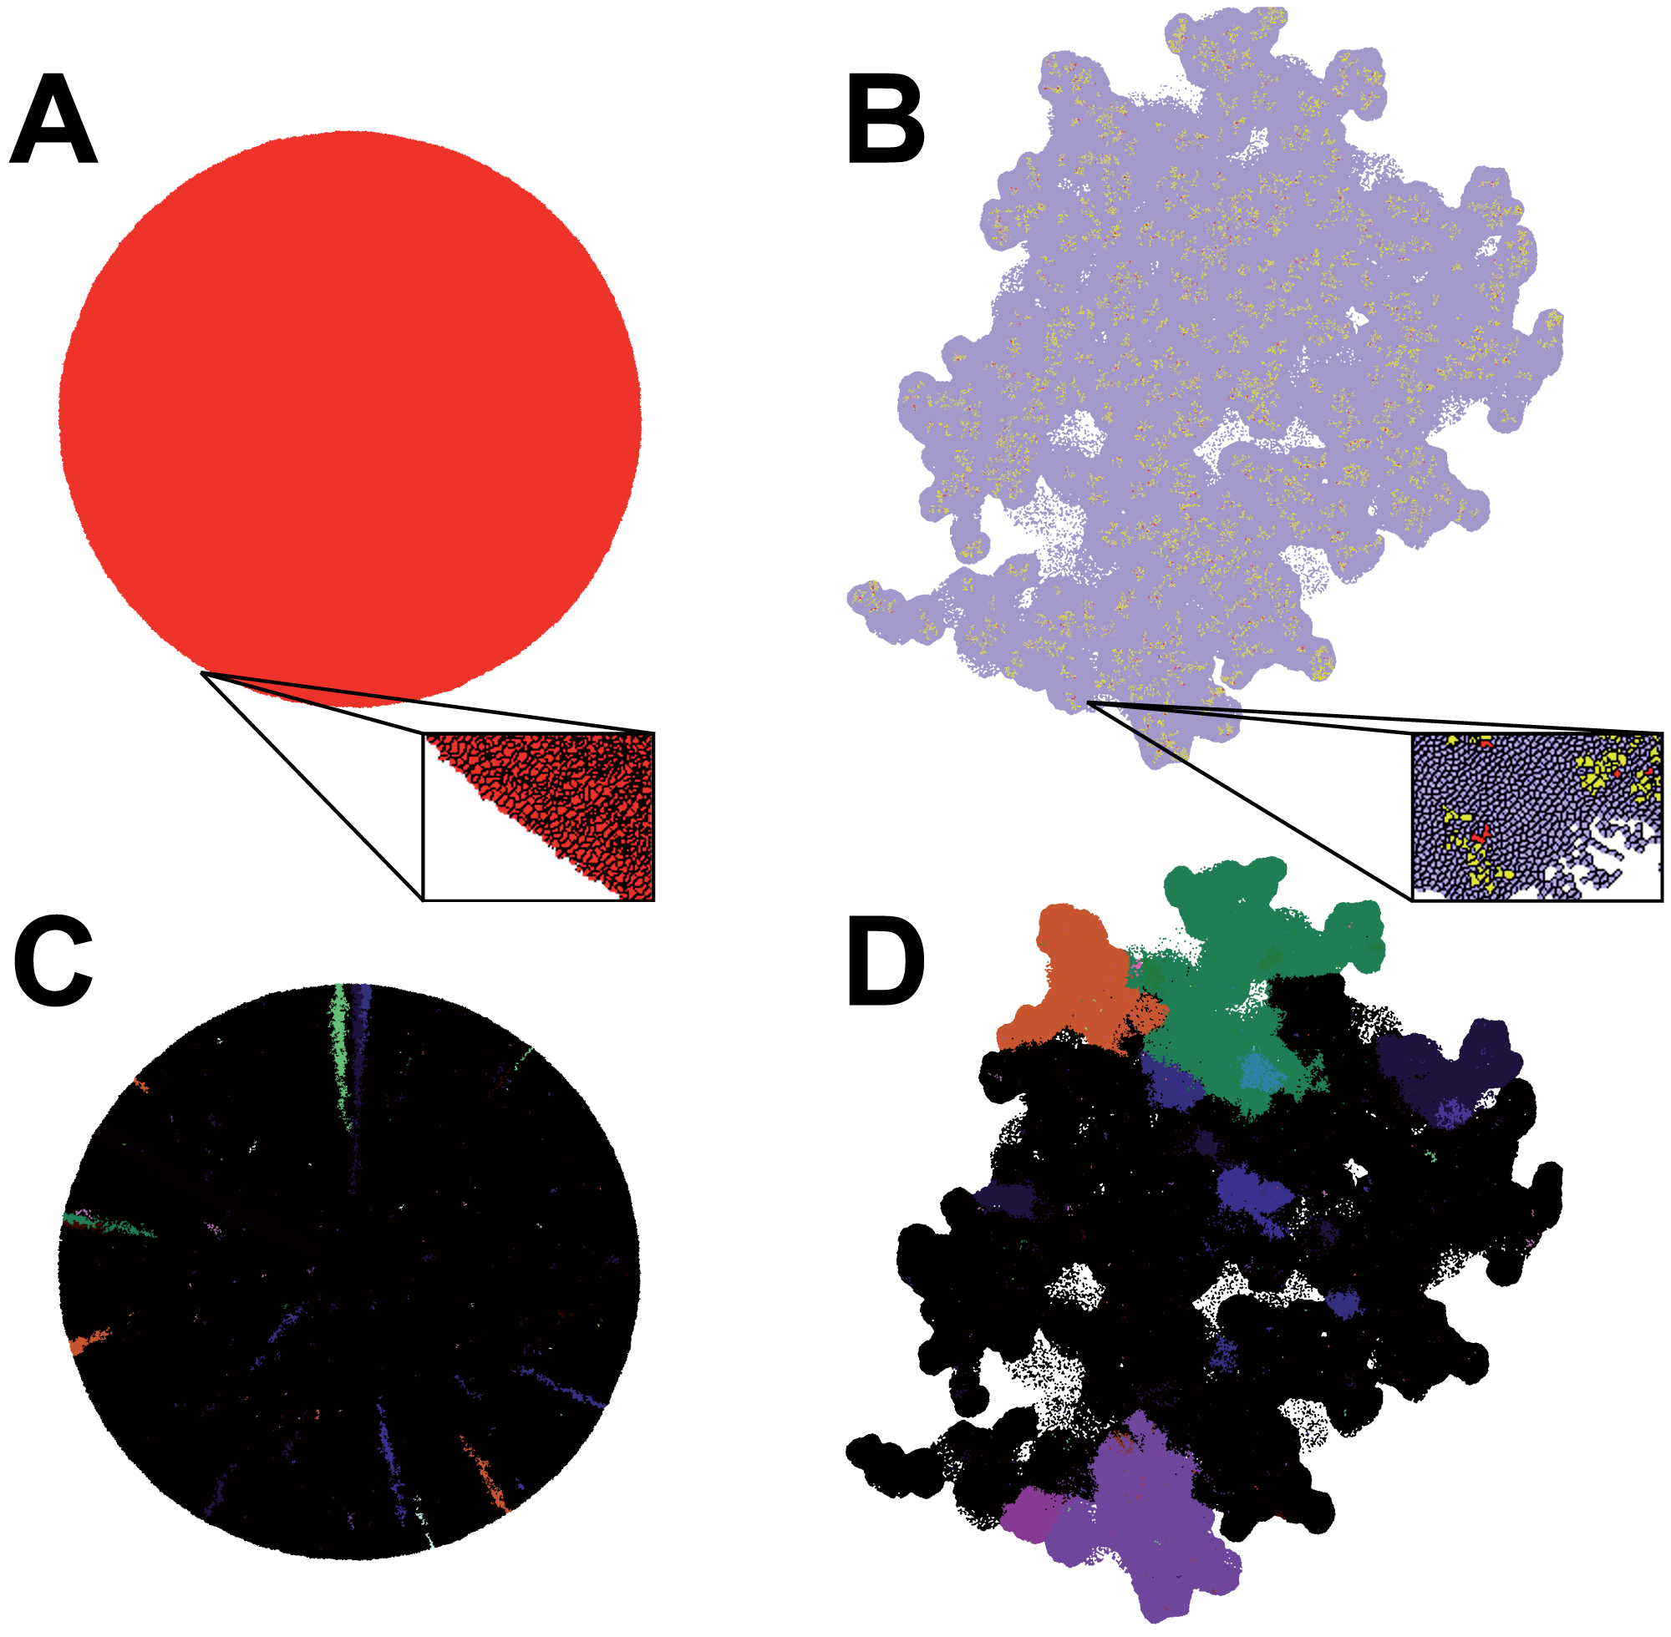
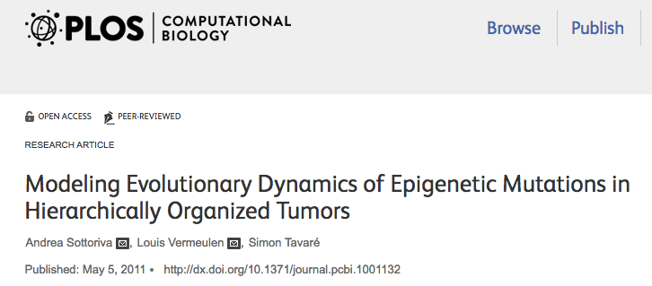

Slide 34
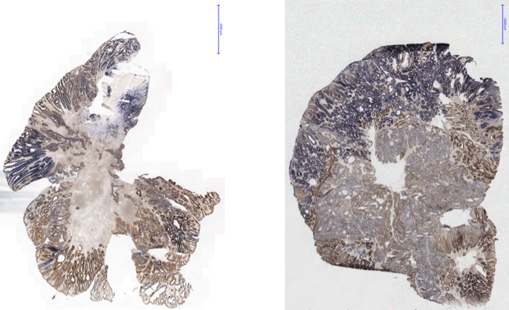
Colony shape data
Trevor Graham, unpublished

Slide 35
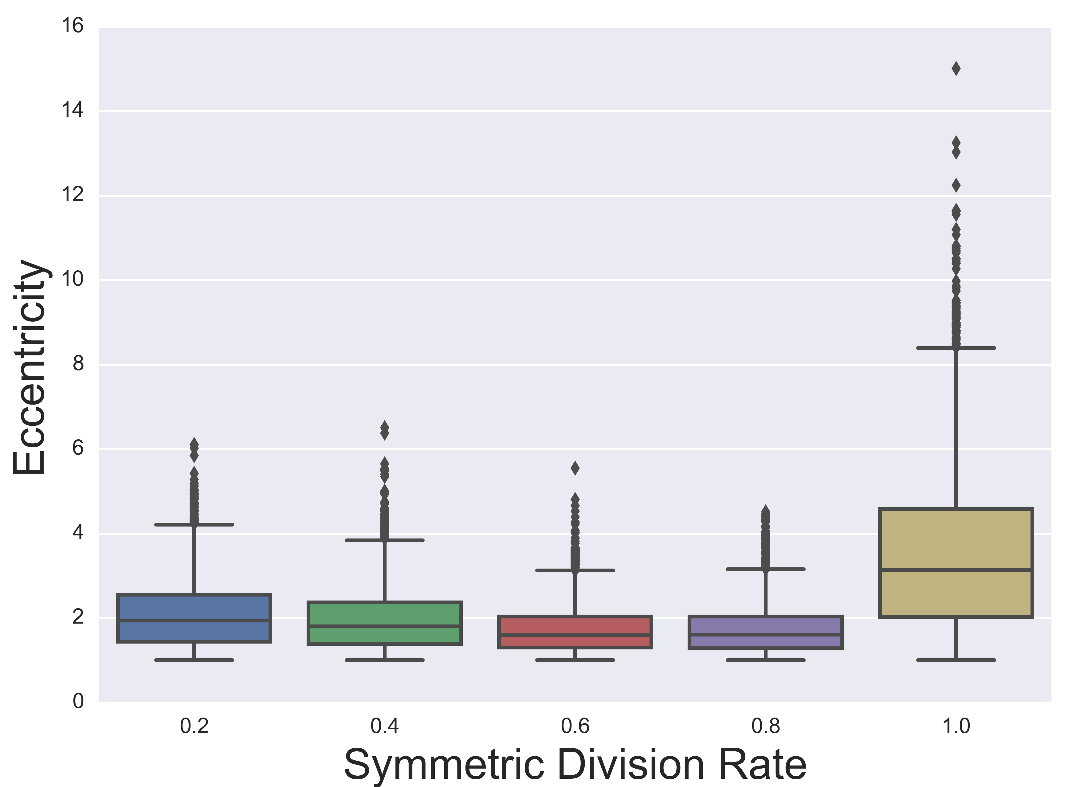
Ratio of major/minor axis in fit ellipse

Slide 36
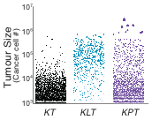
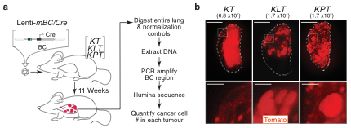
Colony size distributions
Chris McFarland, unpublished

Slide 37
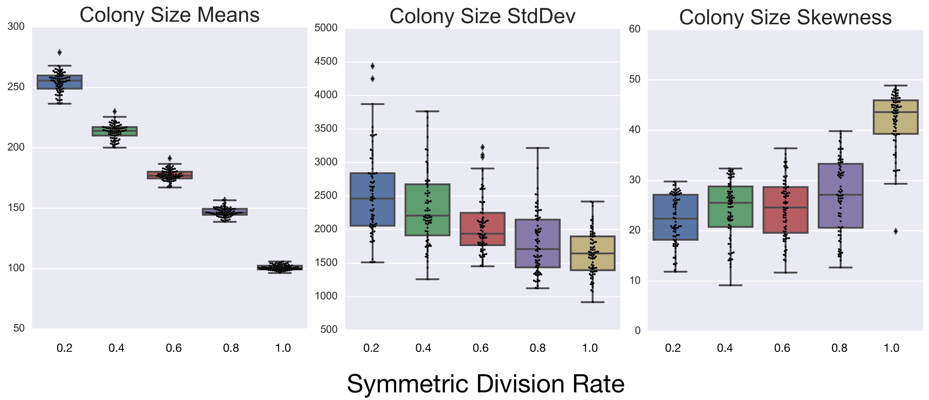

Slide 38
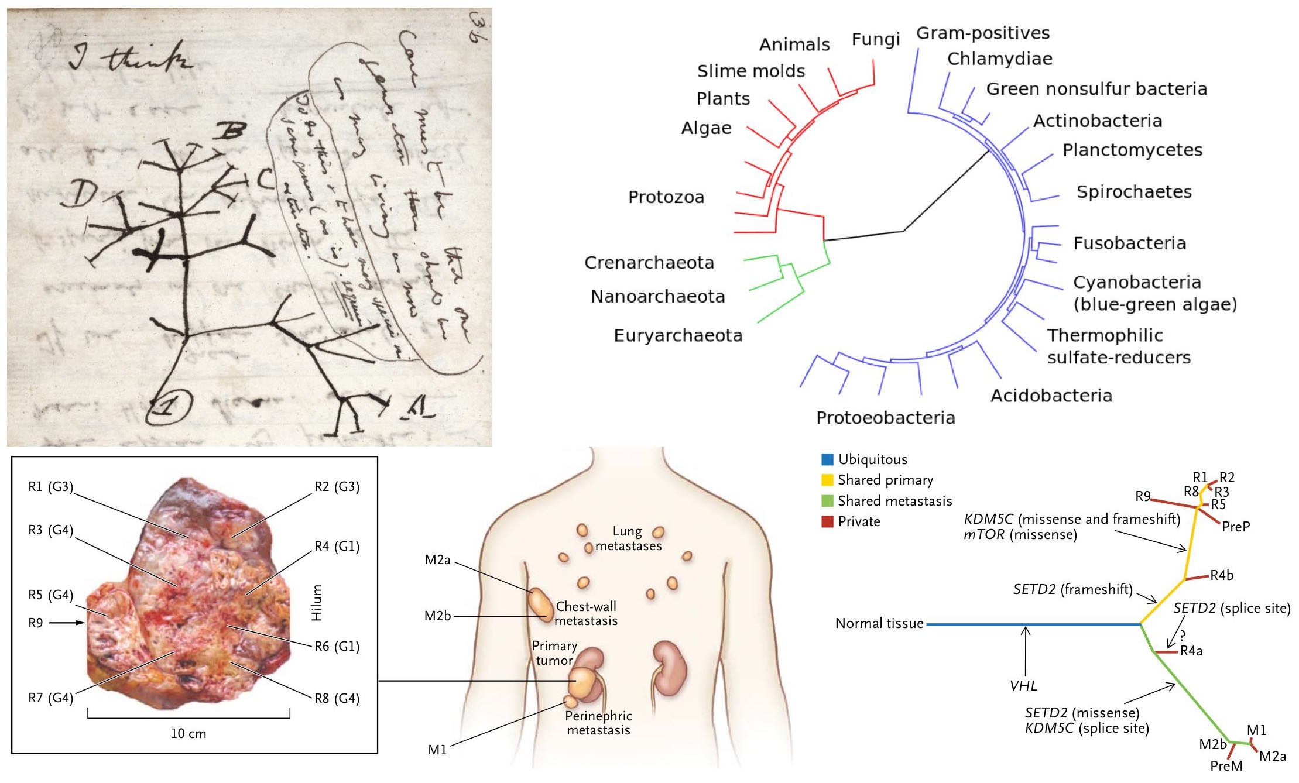

Slide 39
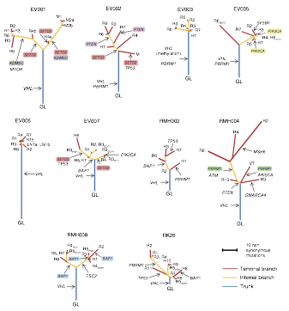
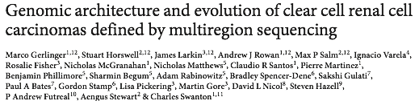
Phylogenetic tree data

Slide 40
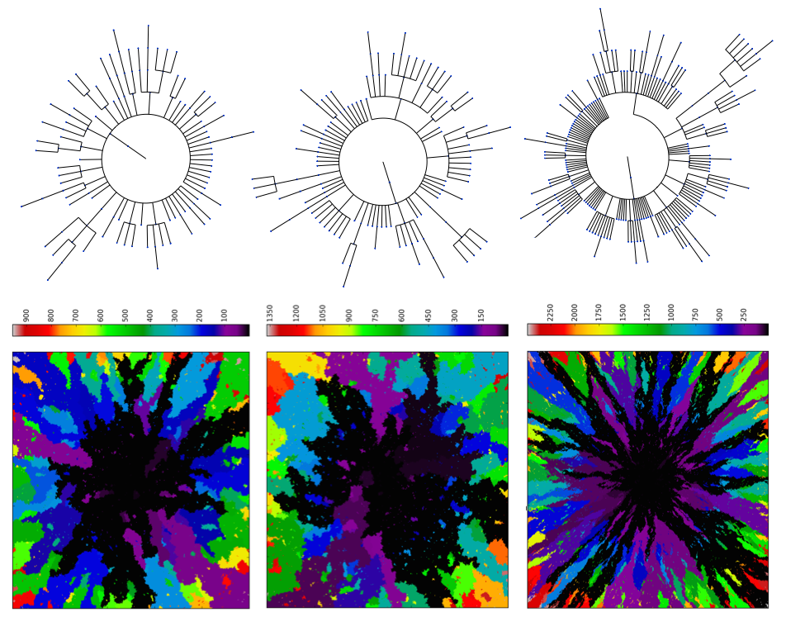

Slide 41
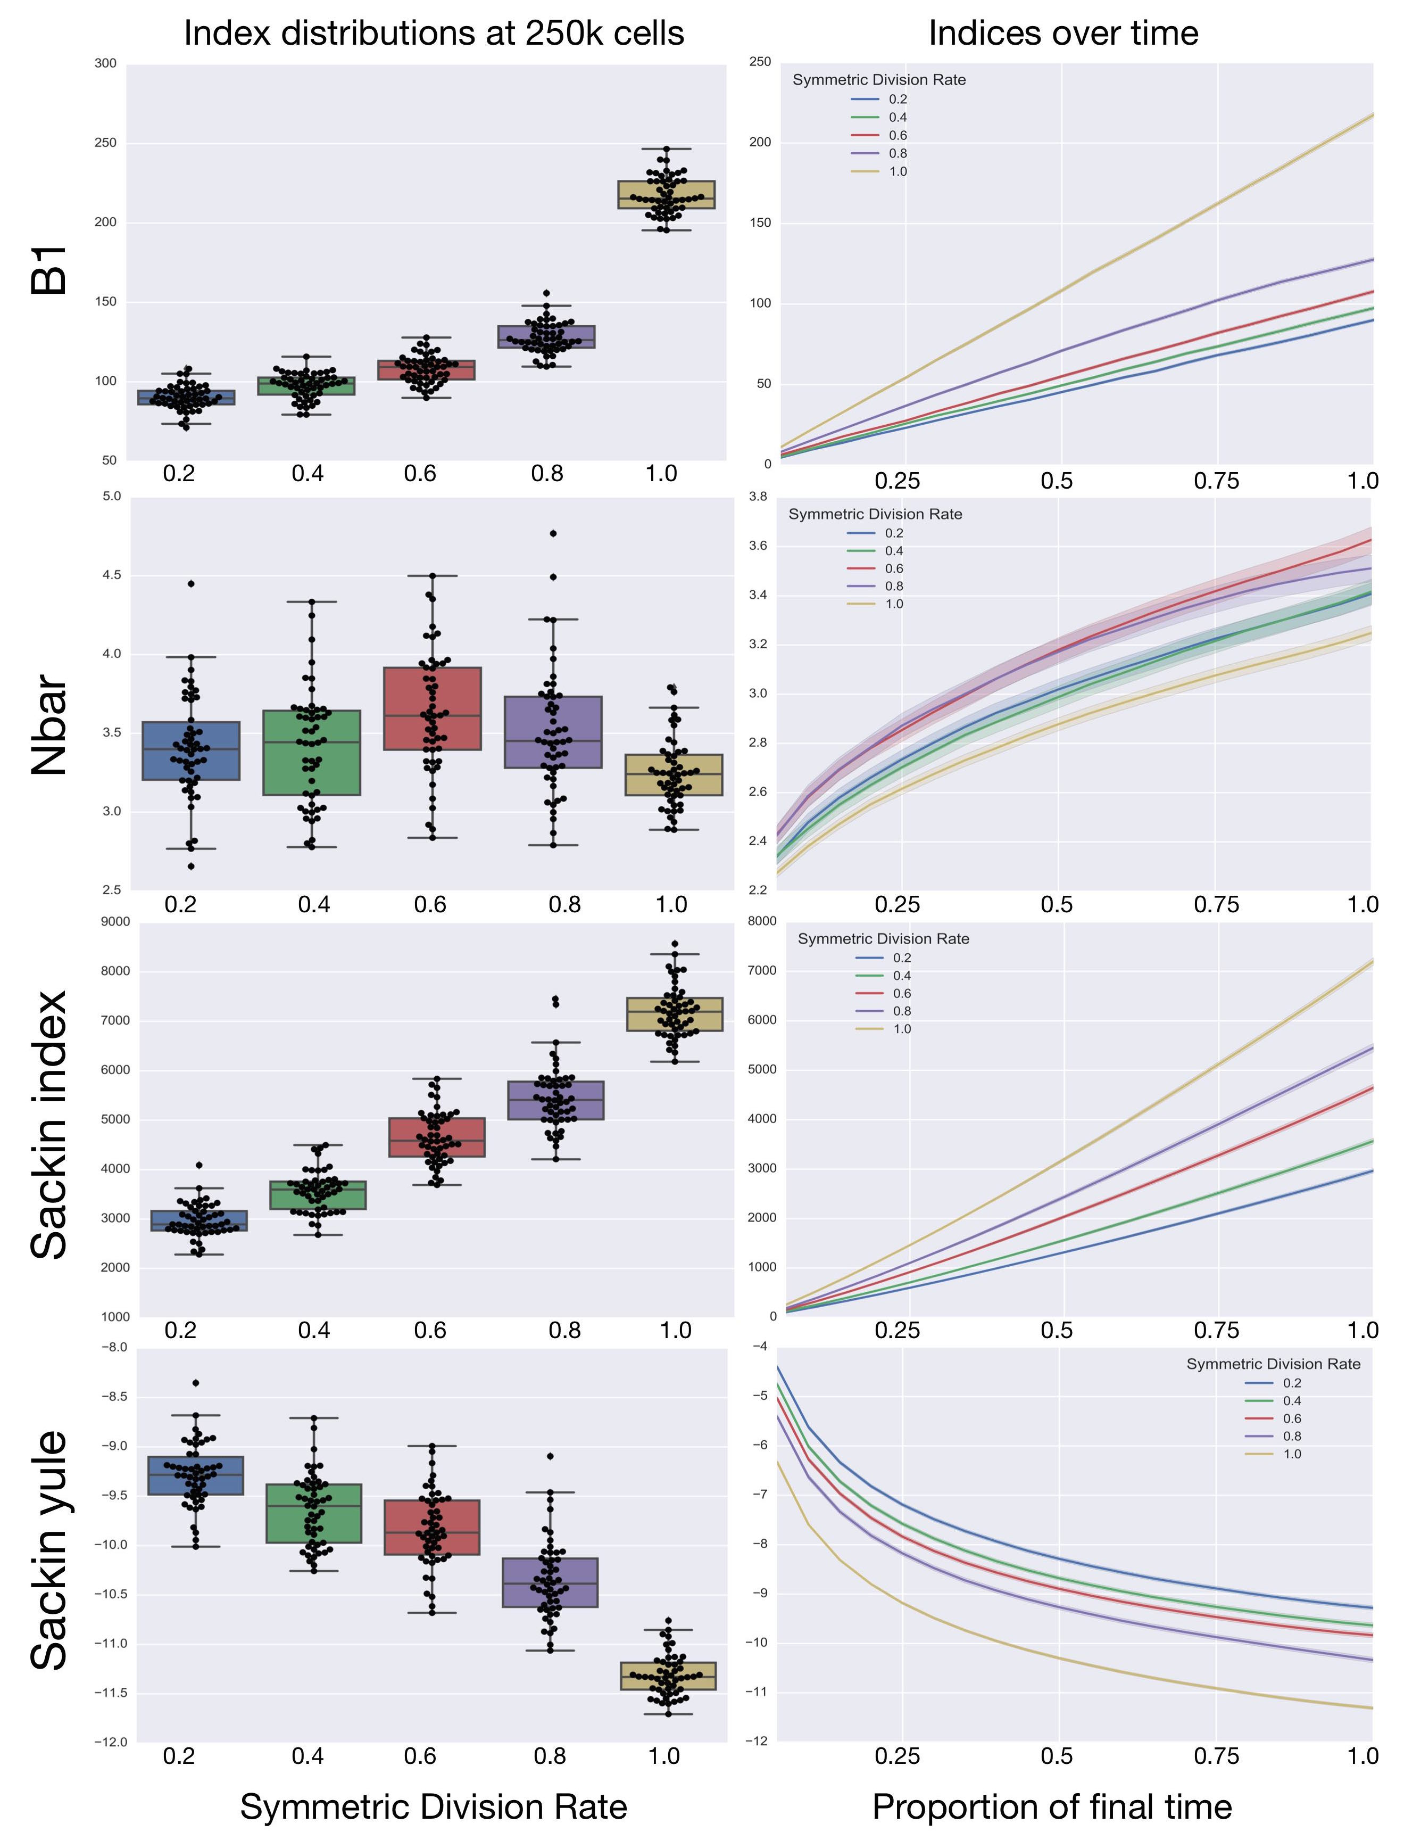

Slide 42
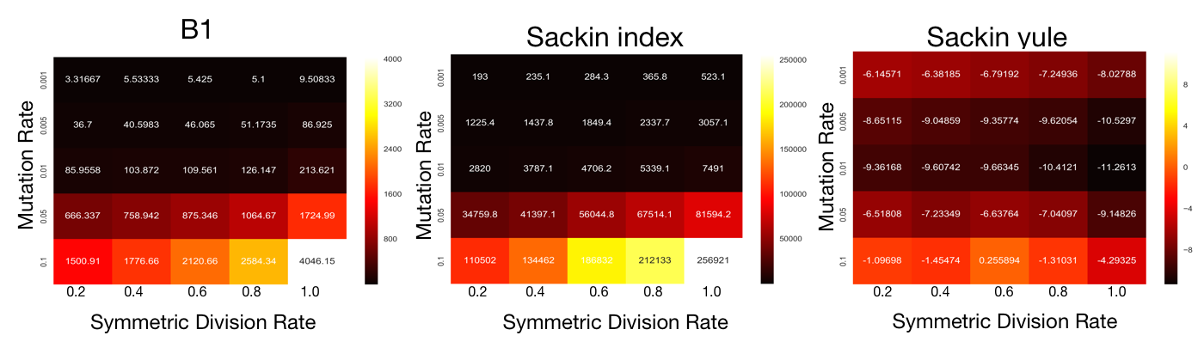

Slide 43
Conclusions
Cancer stem cells may or may not be real…
Assuming they are real, they are important!
Measuring the parameters of cancer stem cell dynamics is hard
Inferring the parameters seems possible from available data - at least we should be able to tell if a tumour is stem driven or not

Slide 44

Comparing individual-based approaches to modelling multicellular tissues

Slide 45
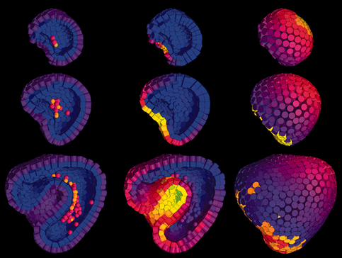
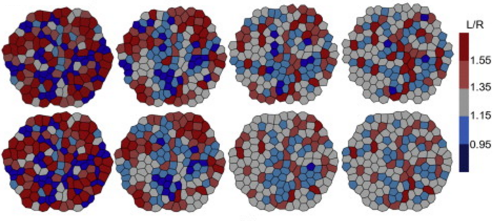
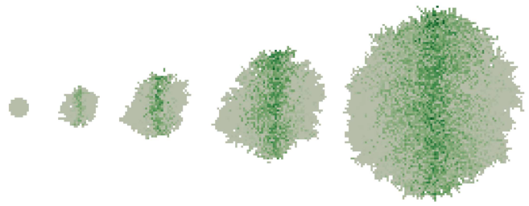
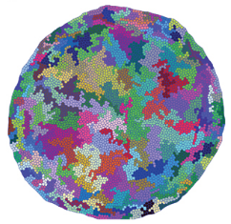
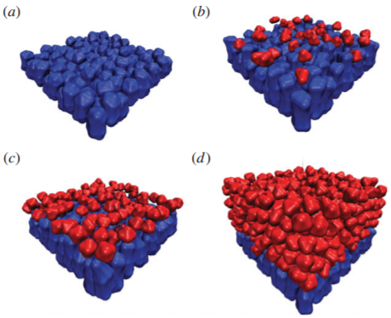
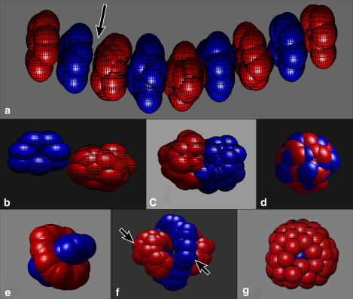
Xiong et al, Cell (2014)
Marin-Riera et al, Bioinformatics (2016)
Osborne et al, PLOS Comput Biol (2017)
Mao et al, EMBO J (2013)
Gord et al, J R Soc Interface (2014)
Shinbrot et al, Biophys J (2009)
Notes:
Compare models?
CBC paper

Slide 46
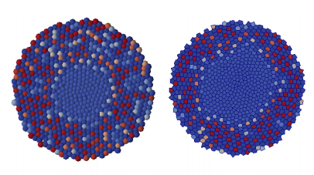
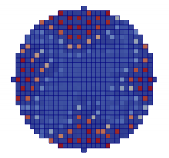
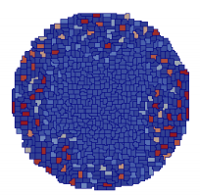
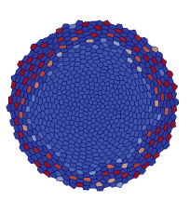
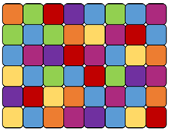




Comparing models
Cellular
automaton
Cellular
Potts model
Overlapping
spheres
Delaunay
triangulation
Vertex
model

Slide 47

Adhesion
CA
CPM
OS
VT
VM
Notes:
For instance, in the adhesion example the CP and VM models are designed to explicitly represent cell sorting (through cell boundary energy terms) whereas the other models needed modification to represent the same phenomena.
In fact, in the OS and VT (and to some extent the VM) models, the ability to sort completely was limited by the presence of local energy minima and a noise component of cell motion was required to mitigate this.
However, as the level of noise was increased, artefacts can be introduced into the models, for example the tessellation may become non-conformal leading to voids in the tissue.
A key difference between the models we considered lies in the definition of cell connectivity.
It is possible for cells in the same configuration to have different neighbours under different
models. For example, when under compression, cells in the OS model can have more
neighbours than similarly sized cells in the CP, VT or VM models. The effects of this can be
seen in the short-range signalling example with a high degree of proliferation.
The coordinated behaviour of populations of cells plays a central role in tissue growth and
renewal. Cells react to their microenvironment by modulating processes such as movement,
growth and proliferation, and signalling. Alongside experimental studies, computational
models offer a useful means by which to investigate these processes. To this end a variety
of cell-based modelling approaches have been developed, ranging from lattice-based cellular
automata to lattice-free models that treat cells as point-like particles or extended shapes.
However, it remains unclear how these approaches compare when applied to the same biological
problem, and what differences in behaviour are due to different model assumptions
and abstractions. Here, we exploit the availability of an implementation of five popular cellbased
modelling approaches within a consistent computational framework, Chaste (http://
www.cs.ox.ac.uk/chaste). This framework allows one to easily change constitutive assumptions
within these models. In each case we provide full details of all technical aspects of our
model implementations. We compare model implementations using four case studies, chosen
to reflect the key cellular processes of proliferation, adhesion, and short- and longrange
signalling. These case studies demonstrate the applicability of each model and provide
a guide for model usage.

Slide 48

Proliferation, differentiation, death
CA
CPM
OS
VT
VM
Notes:
The implementation of other features, such as boundary conditions, can also influence simulation outcomes.
This was observed in the proliferation example where the rate of neutral drift was significantly different in the VM compared to the other models, due to additional adhesion of cells to the bottom of the domain.

Slide 49
Conclusions
 | Cellular automaton | Cellular Potts model | Overlapping spheres | Voronoi tessellation | Vertex model
Adhesion |  | ‘Model’ problem | No engulfment | No engulfment | ‘Model’ problem
Proliferation | No cell compression
Short-range signalling | Lattice artifacts | Lattice artifacts | Copes with compression
Long-range signalling | Lattice artifacts |  |  | Ready-made for FEM
Highly appropriate Appropriate Less appropriate
Osborne et al, PLOS Comput Biol (2017)

Slide 50
Acknowledgements
Andew Dhawan (Oxford)
Trevor Graham (Barts Cancer Institute)
Jacob Scott (Cleveland Clinic)
Philip Maini (Oxford)
Sandy Anderson (Moffitt Cancer Center)
James Osborne (Melbourne)
Joe Pitt-Francis (Oxford)
David Gavaghan (Oxford)

Slide 51
Any questions?
Email: a.g.fletcher@sheffield.ac.uk

